Slide 1
″AGROECOLOGICAL CONDITIONS FOR GROWTH AND DEVELOPMENT OF WINTER WHEAT IN AUTUMN-WINTER PERIOD″
Daria Blyshchyk, Master student
Scientific advisor: Olena Dronova,
PhD (Geography), Assistant Professor

Slide 2
Winter Wheat

Slide 3
Table 1. Moisture Supply of Winter Wheat Plants by the Moment of Termination of Vegetation in Autumn
The province | Sowing | Termination of vegetation | Duration of the period, days | % of aridity from the total number of ten-day periods
 |  |  |  | dry | droughty
Odessa | 23.09 | 17.11 | 55 | 8 % | 15 %
Mykolaiv | 18.09 | 18.11 | 61 | 7 % | 19 %
Kherson | 24.09 | 24.11 | 61 | 20 % | 20 %

Slide 4
Table 2. Dates of Transition of Air Temperature through 0⁰С and –5⁰С and +5⁰С і 0⁰С in Autumn
The province | Dates of transition through 0⁰С | Dates of transition through -5⁰С | Duration of the period, days | Dates of transition through +5⁰С | Duration of the period, days
Odessa | 27.11 | 13.12 | 12 | 15.11 | 17
Mykolaiv | 26.11 | 18.12 | 20 | 06.11 | 23
Kherson | 04.12 | 28.12 | 21 | 13.11 | 24

Slide 5
Table 3. General Characteristics of Winter Conditions in the Black Sea Region
The province | The average number of days with thaw, days | Duration of winter period, days | Σ(-Т˚С) | The average value of absolute minimum of air temperature
Odessa | 47 | 77 | 377 | -19,7
Mykolaiv | 37 | 83 | 355 | -19,8
Kherson | 49 | 84 | 407 | -17,4

Slide 6
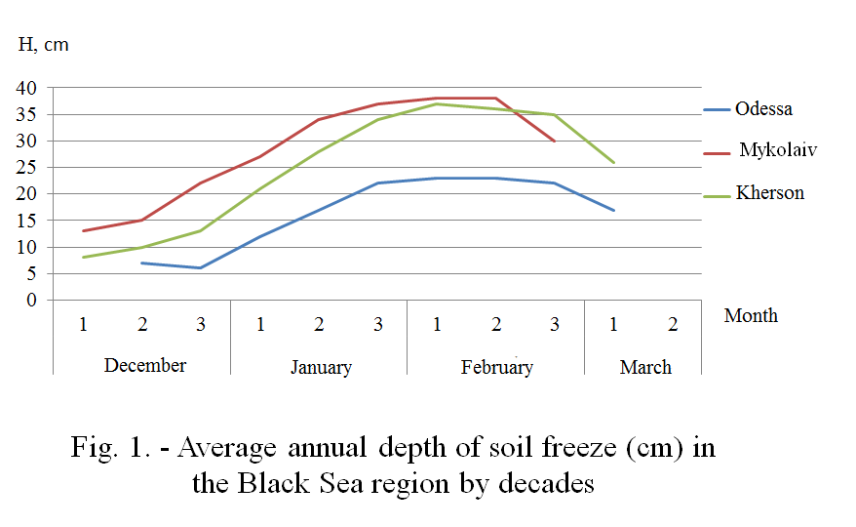

Slide 8
Table 4. Estimation of Wintering Conditions for Winter Wheat Plants (according to V.А. Moyseychyk)
The province | Sprouts of stilling capacity |  | The number of stalks per 1 m² |  | Living stalks, % | Estimation of wintering conditions
 | autumn | spring | autumn | spring
Odessa | 3 | 3 | 1075 | 1206 | 112 | Good
Mykolaiv | 3 | 3 | 990 | 1080 | 98 | Satisfactory
Kherson | 2 | 3 | 780 | 911 | 111 | Good

Slide 9
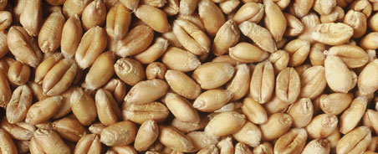
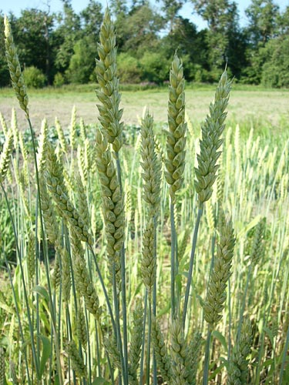
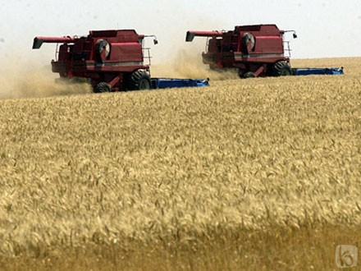
Winter Wheat Yield

Slide 10
Thank you for your kind attention!

